Slide 1
Auros Reporting Tool Technical User Guide v 1.3
Frank Nauroth, Siemens GFA 2018

Slide 2
Project Scope
Scope of this Project is to create an Interface to Auros for Reporting.
The Report should be configurable and the output format should be Excel. The Tool to create the Report should be command line driven.

Slide 3
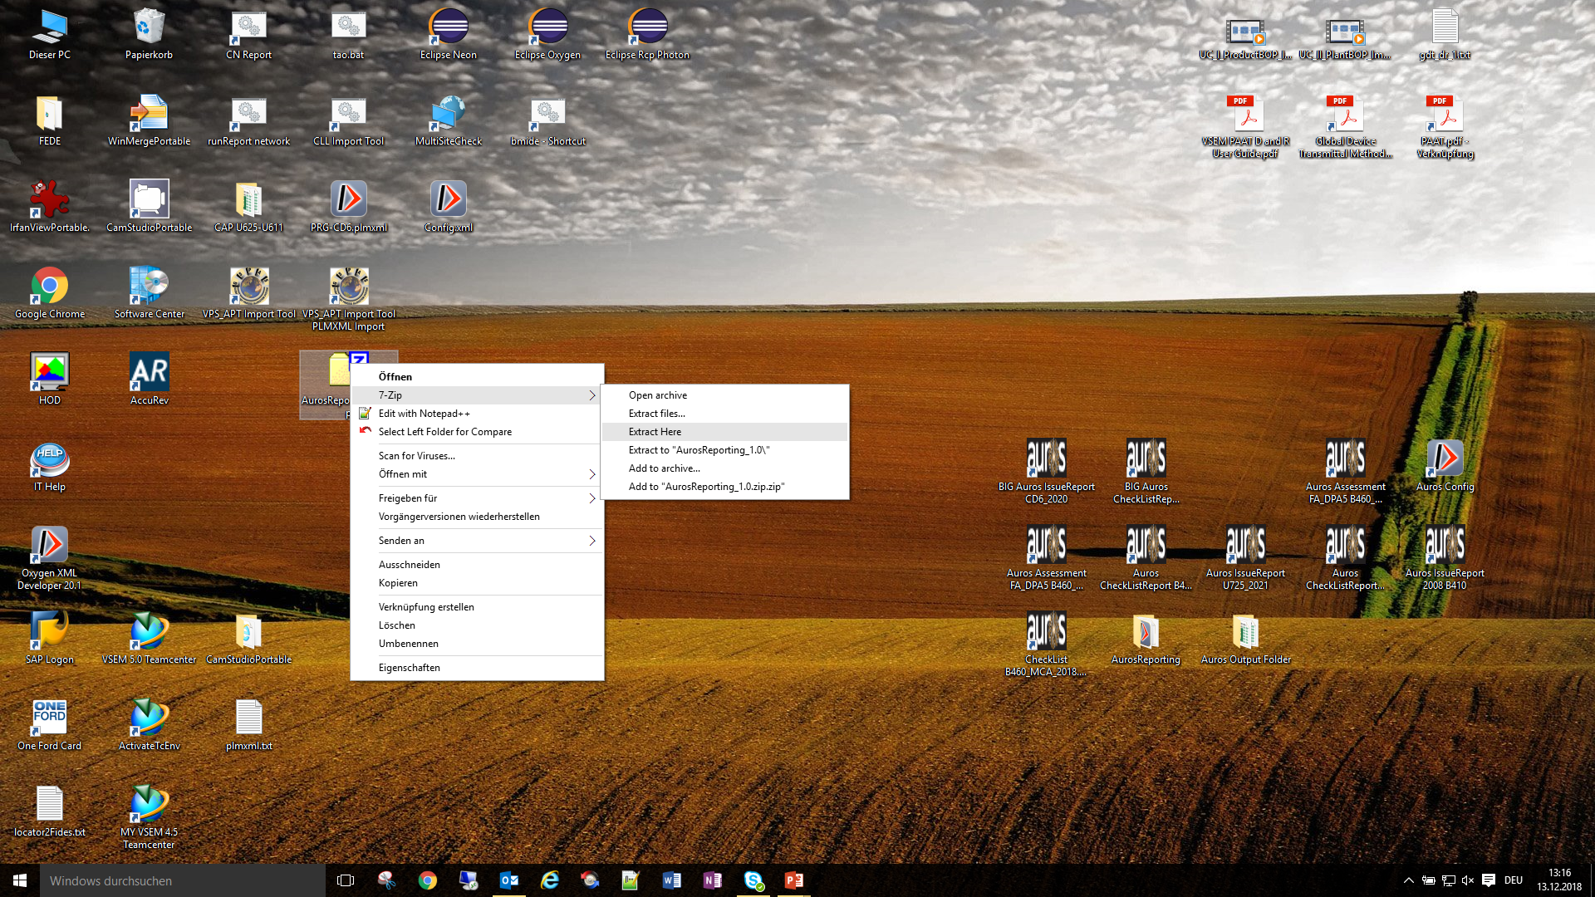
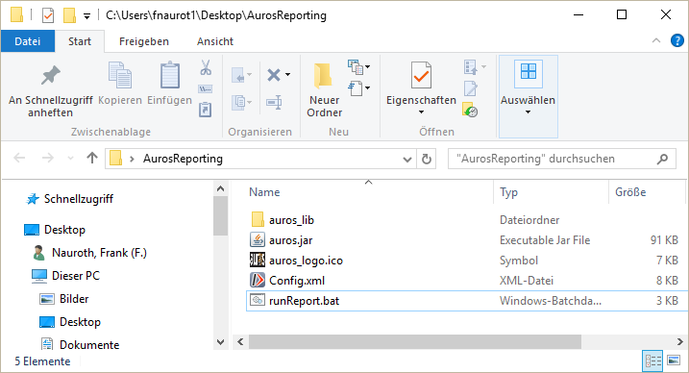
Report Tool Installation
Installation can simply be done by extracting the installation zip file somewhere. This will create a directory named “AurosReporting”.
Content of the installation directory will be
runReport.bat
This is the executable batch file
It contains the java call, some help and samples
Config.xml
The central configuration file of the tool
More details will be explained on the next slide
auros.jar
File containing all Java based functionality
auros_lib
Directory containing some java libraries
auros_logo.ico
Some auros logo can be used as tool icon

Slide 4
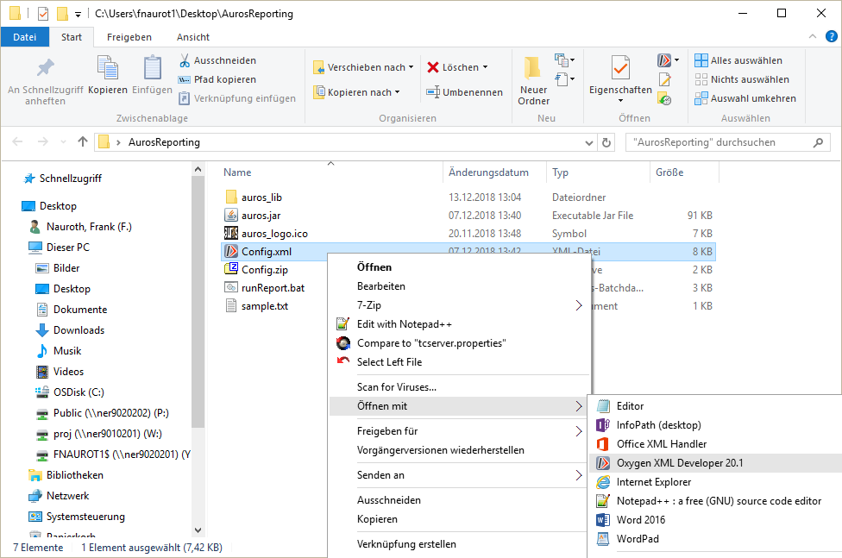
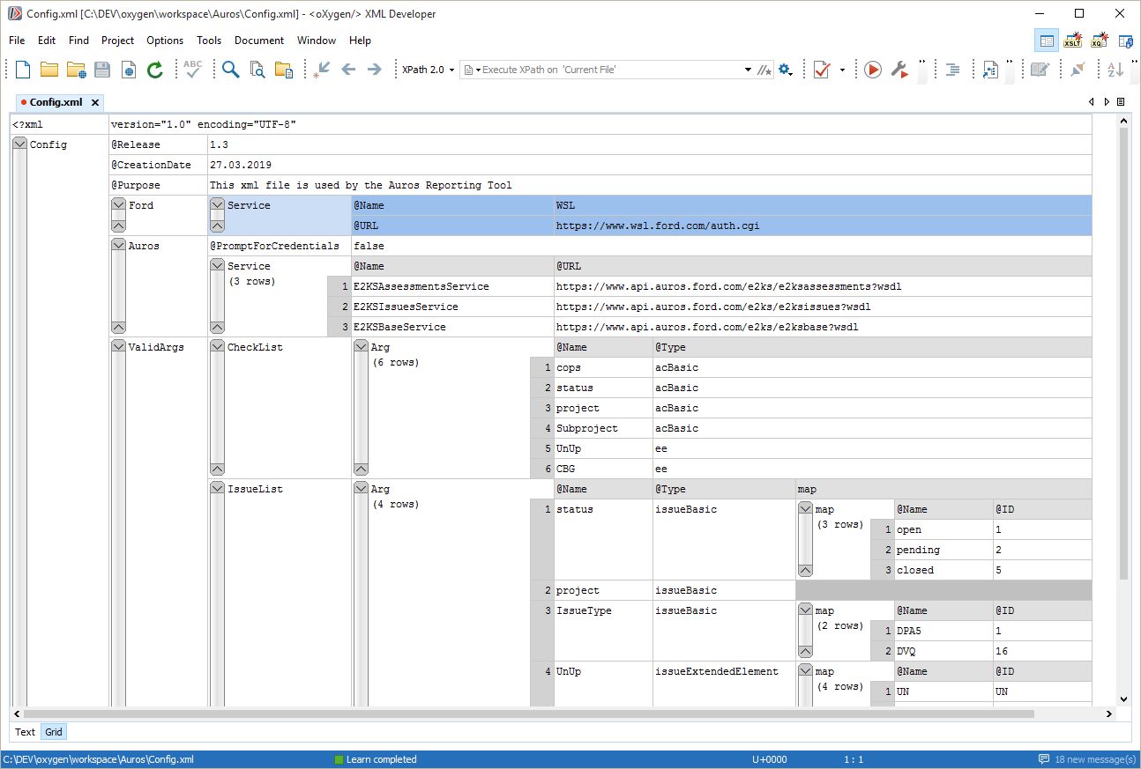
Configuration of the Tool
Open the file “Config.xml using some XML Editor
The Ford Software Center offers the Oxygen XML Developer Software for everybody
After opening the file with “Oxygen”, choose “Grid” as view at the lower left corner of the Editor to get best viewing capabilities

Slide 5
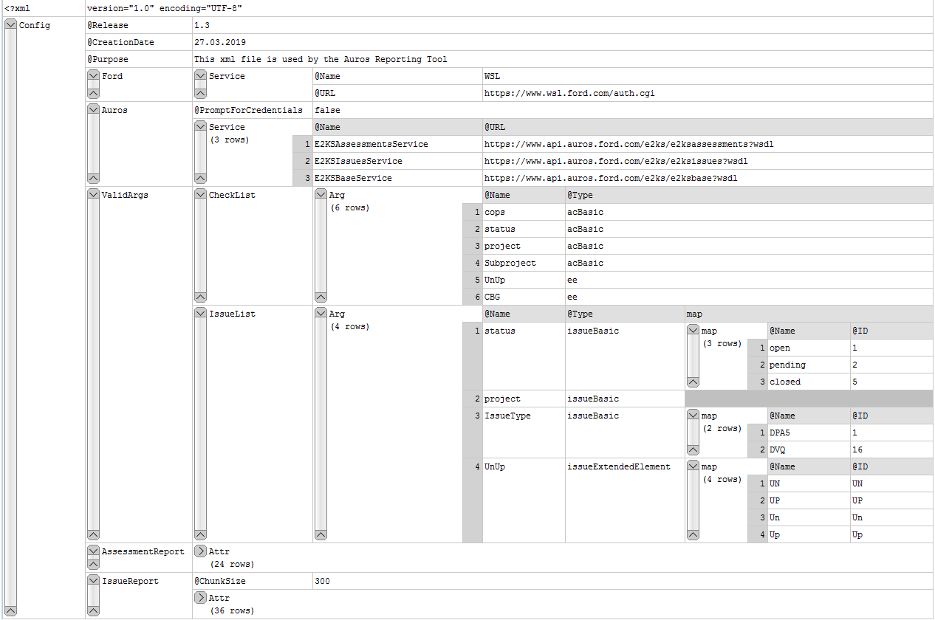
Configuration of the Tool
Configuration File Content
Release Information Creation Date and Purpose of this file
The Ford section contains the URL of the Ford Web Single Login
The Auros section contains the flag for interactive or parameterized login and the Names and URLs of the Auros Web Services.
With the flag PromptForCredentials set to “false”, the tool expects credentials as parameter. Supported values are “true” and “false”
The URLs shown in the “Services” section indicates that the Productive Environment is used here
The CheckList section contains all valid query arguments used by the Tool for Assessments Reports.
They all can be used with single or multiple values as parameter to run the tool
When using multiple values, they must be separated by comma
The Type assignment is used internally by the tool and should not be changed
The IssueList section has the same structure and rules like the CheckList section but it is used to configure Issue Reports.
In addition most attributes contains a fix list of values, where some internal mapping is required. In this case no other values are allowed.
The AssessmentReport and IssueReport section contains the properties which should be stored as the result in the Excel File.
In addition the IssueReport section contains a parameter “ChunkSize” to split up Issue queries into chunks. This will avoid that the Auros Reporting Tool will exceed some time limit set in Auros (details see next slide)

Slide 6
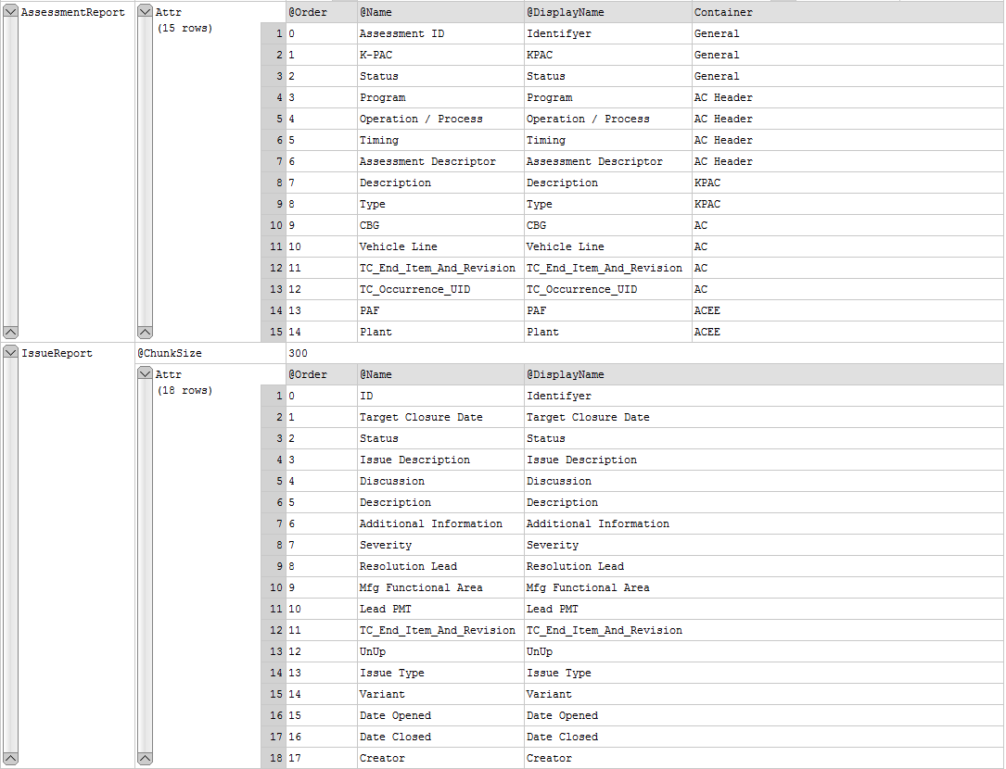
Configuration of the Tool
Configuration File Content
General Rule: Less Properties will cause a faster report results
AssessmentReport section contains the Names and the Container of the attributes to be reported for assessments.
The Order will be used as the order of attributes in the resulting Excel file The Name is used as internal name.
The DisplayName is used as header name in Excel an can be changed.
The Container definition is not used by the tool, but if it is possible to remove all attributes belonging to the same container the tool will work faster
ChunkSize is set to 150. This will query for 150 Issues at once. For example the tool would perform 10 issue queries to report 1500 Issues using this setting. Can be changed in case of report issues for “IssueReports”
IssueReport section contains the Names of the attributes to be reported for issues. For issues there is no such “container” mechanism.
Same as for Assessments the Order will be used as the order of attributes in the resulting Excel file, the Name as some internal name for the DisplayName as the header name in Excel

Slide 7
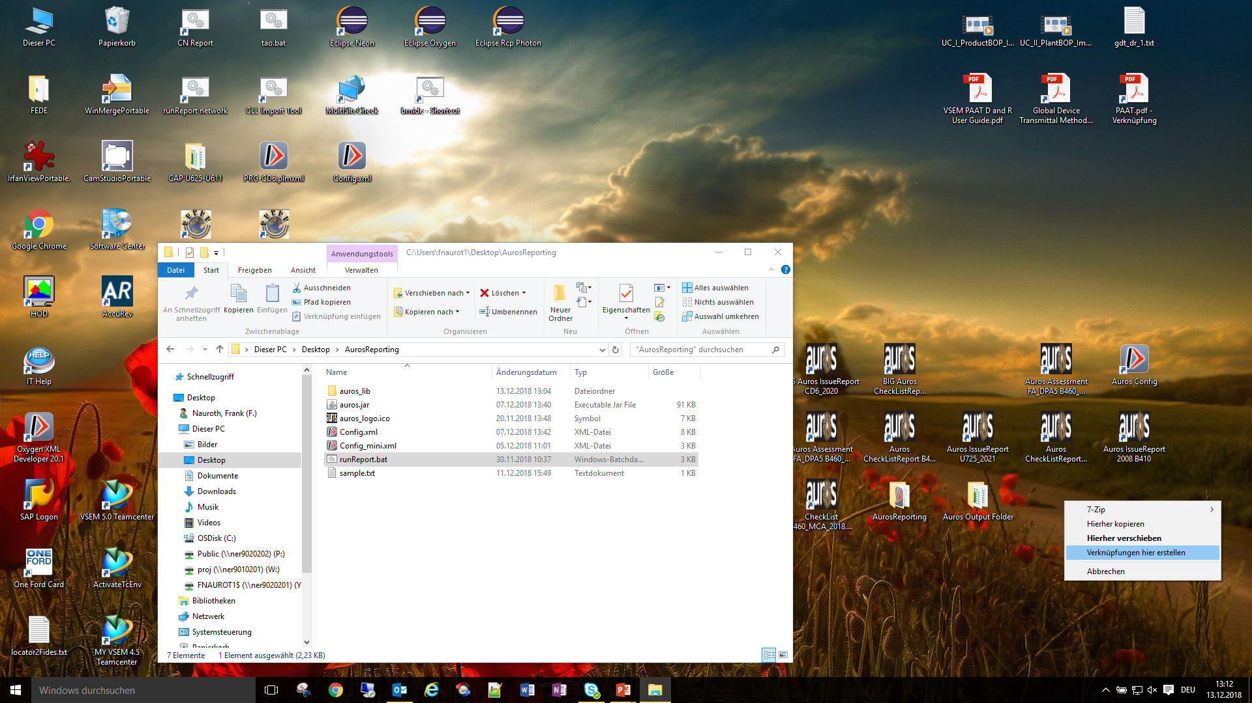
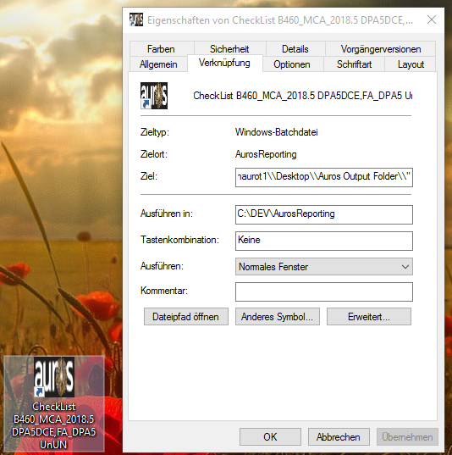
Report Setup
My recommendation is to create a “shortcut” of the “runReport” batch file
to avoid typing long parameters every time you create a report
Properties of the shortcut
Use the “Target” to specify details of functionality (see next slide for details)
4
Change Symbol, if you like.
Some Auros Icon is located in the installation directory
Create a shotcut from the “runReport.bat” to e.g. your Desktop (use the right mouse button)
1
Give some meaningful name to the shortcut
2
3

Slide 8
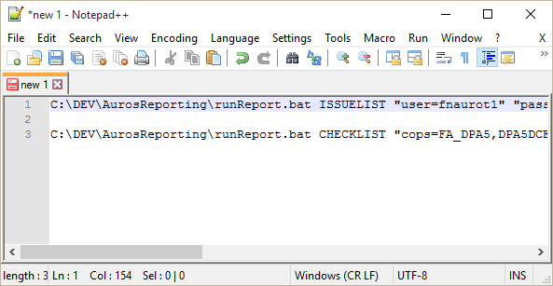
Report Setup (cont.)
Properties of Shortcut
Specify the Target for functionality details. Recommendation: Use some Editor and copy/paste
For details see next slide

Slide 9
Report Setup (cont.)
Assessment Report
This Assessment Report sample Target (cmd line) uses
parameterized credentials (Important: Usage of interactive credentials needs to be defined in config file. If interactive leave off this parameters here – c.p. page 5)
cops and project as Filter (could be just one or more Filter)
suffix “U725_2021_DPA5_MyTest” as identifier in the Result filename
"C:\Auros Output Folder\“ as the output Folder to store the Result (Important: As shown above, please use double backslashes as directory separator)
*
Issue Report
This Issue Report sample Target (cmd line) uses
parameterized credentials (Important: Usage of interactive credentials needs to be defined in config file. If interactive leave off this parameters here – c.p. page 5)
project and status as Filter (could be just one or more Filter)
suffix “CD6_2020-Pending-Test” as identifier in the Result filename
“C:\Auros Output Folder\“ as the output Folder to store the Result (Important: As shown above, please use double backslashes as directory separator)
*
* Multiple Values for one Filter have to be separated by comma

Slide 10
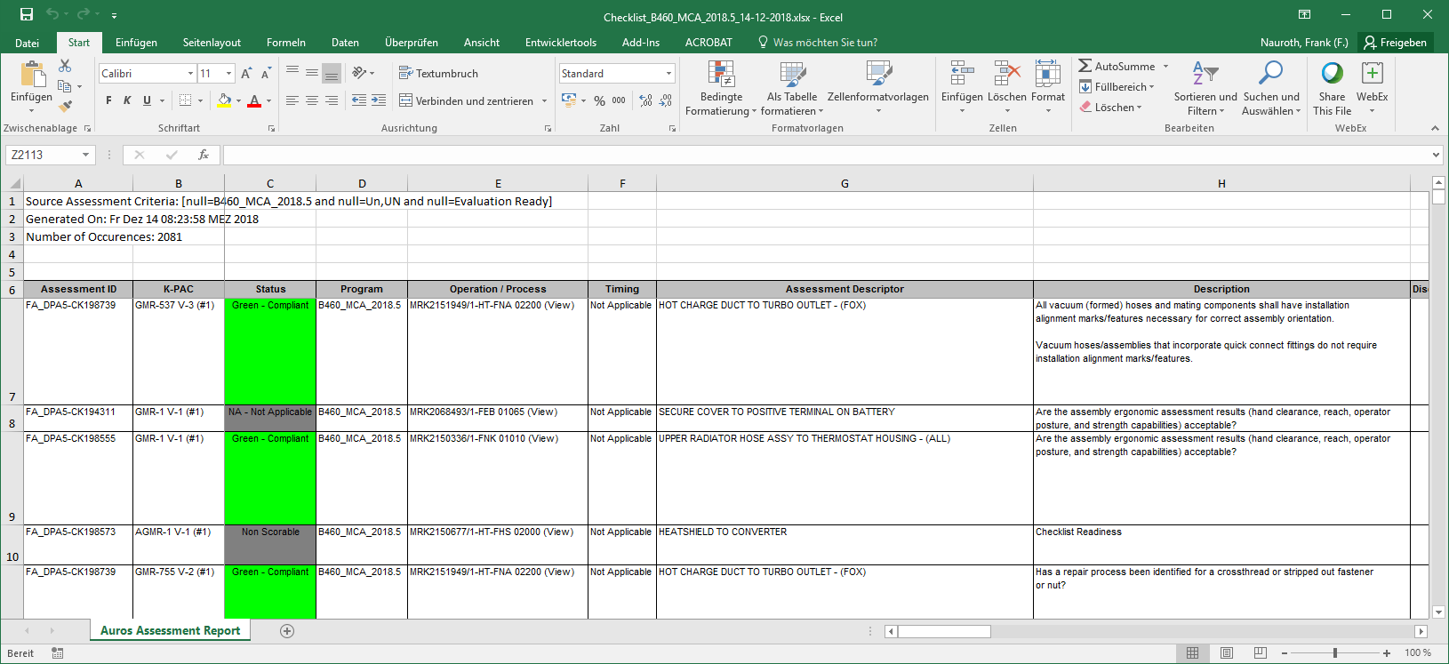
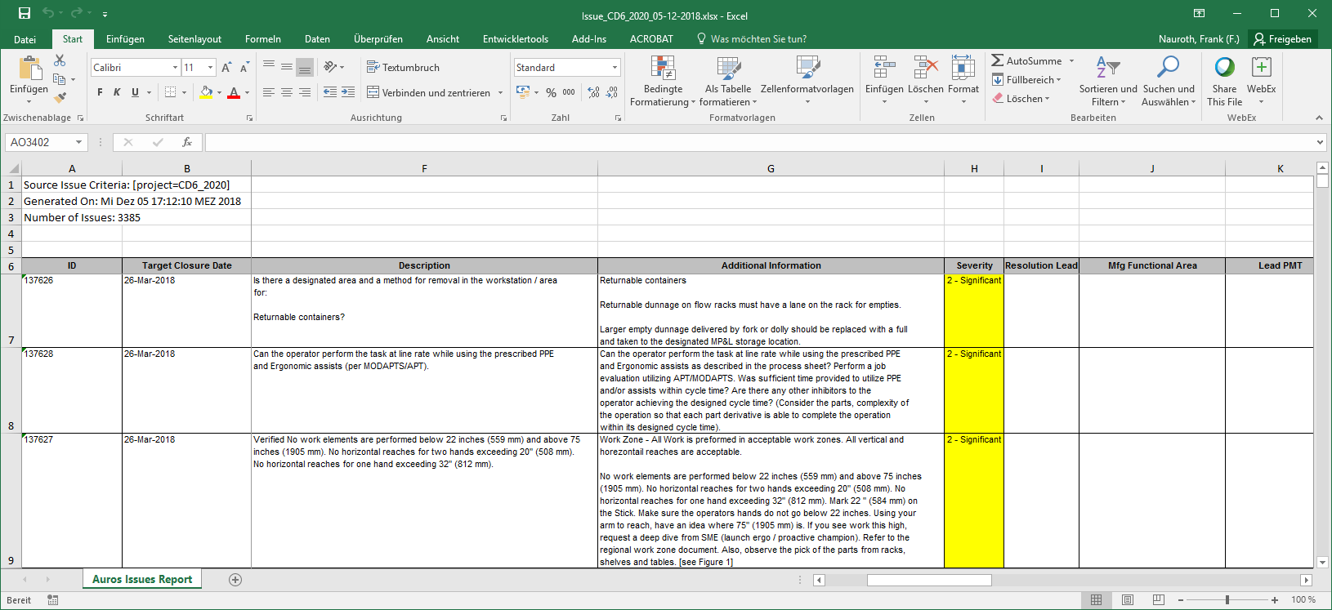
Report Files for Assessments and Issues
The Report Filename Format is always [reportType]_[suffix]_[date].xlsx
Where:
reportType = CheckList | Issue
suffix = free text as cmdline parameter
Date = Date[dd-mm-yyyy]

Slide 11
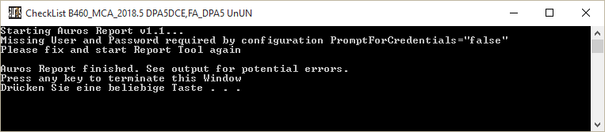
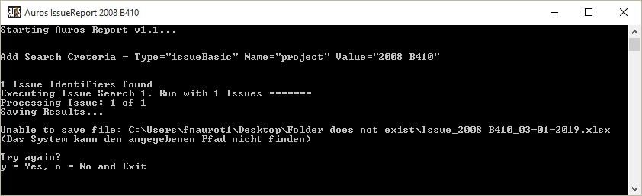
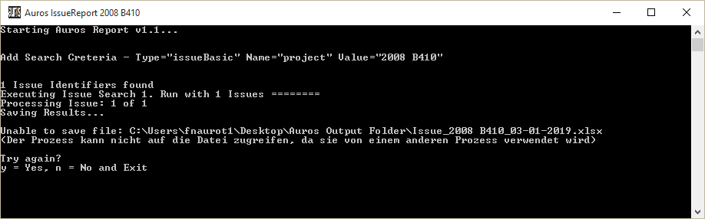
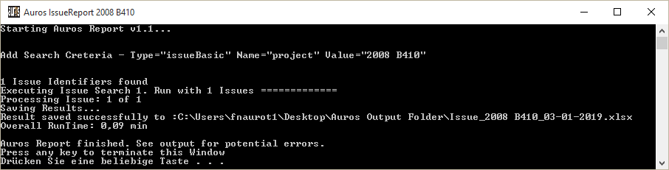
Running The Report Tool And Its Message Output
To start some Auros Report, simply double click the shortcut on your Desktop
You will see messages like shown below:
Tool has been configured for interactive credentials,
but the required parameters are missing
The output folder parameter is wrong (Folder does not exist)
Solution: Fix argument to run the tool (last Target parameter in shortcut)
Temporary workaround: Create Folder as configured and press “y” in the output window of the Tool to save the report
The output file is opened (in Excel) and cannot be overwritten
Solution 1: Close Excel and press “y” to overwrite existing report
Solution 2: Press “n” to exit without saving the current Report
Solution 3: Close Excel, rename the existing file and press “y” to create a new report.
Tool has successfully finished
and saved the Report as configured

Slide 12
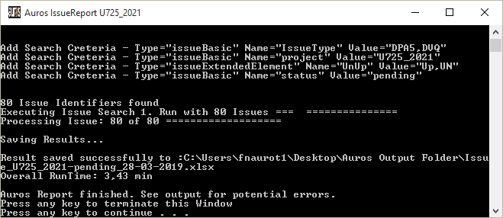
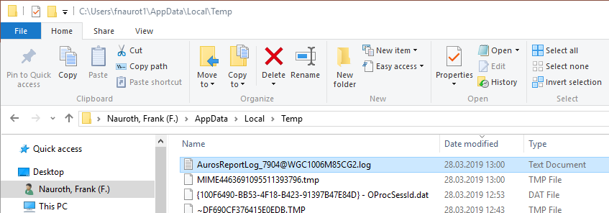
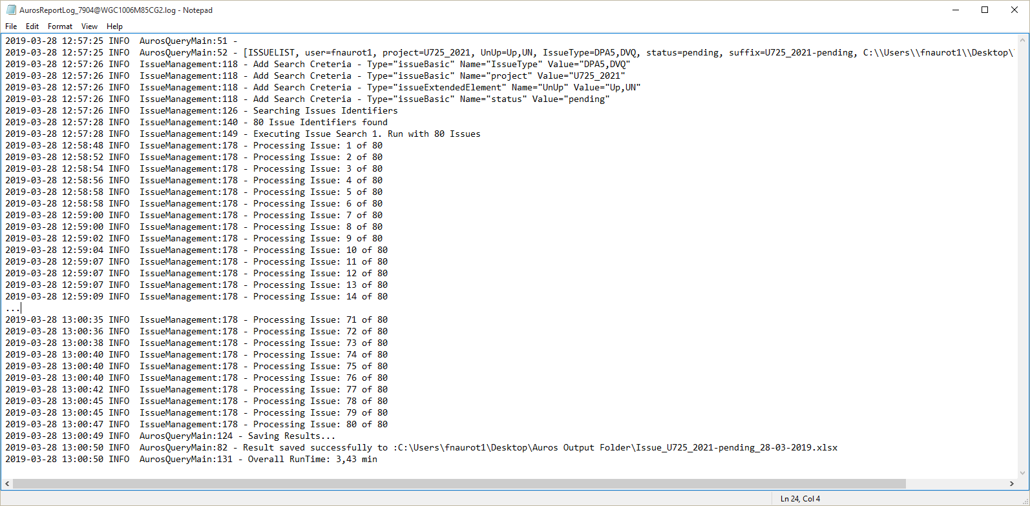
The Report Tool And Error Logging
The Auros Reporting Tool will create a log file in the directory %TEMP%
Extension of the log file(s) is:
The Process Name (PID@Hostname)
Format of the LOG file is:
[DATE TIME] [INFO|WARN|ERROR] [Class:ROW] [TEXT]

